Slide 1
VOTING SYSTEM USING FDR AND OTP
Project Guide:-Hasib Shaikh
Presented By : Rohan Nikam(23)
Rohan Gaonkar (10)
Rohit Kannojia (15)

Slide 2
Need of Project
Online elections help empower members of associations, societies, and other democratic organizations by making voting easy and convenient.
With online voting there are no rejected, mismarked or invalid ballots. Results are automatically calculated, eliminating the need for manual tabulation and dreaded recounts. Computerized tabulation allows election managers to quickly announce decisions and results.
This application saves the time of user.

Slide 3
Problem Statement
Online Voting are simple, attractive and ease to use. It reduces manual efforts and bulk of information can be handled easily. But out of all these features there are some drawbacks with this system are, there can be paper-based voting, electronic voting machine. Voting is the major issue as the identification of the person is the most important issue. As they do not have mostly the identity proof rather than the voting card & the fake voting is done on the large scale

Slide 4
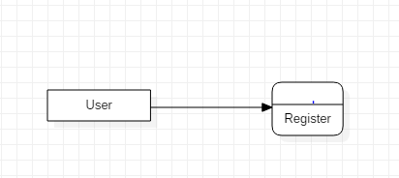
Dataflow Diagram
1.User data flow diagram:-
Level 0:-

Slide 5
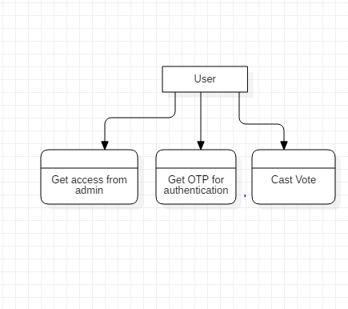
Level 1:-

Slide 6
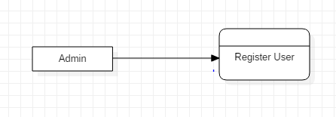
Dataflow Diagram
1.Admin data flow diagram:-
Level 0:

Slide 7
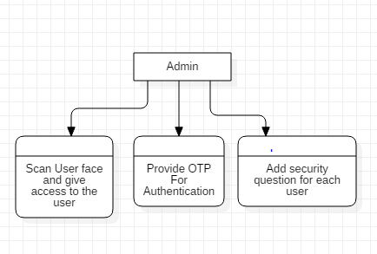
Level 1:-

Slide 8
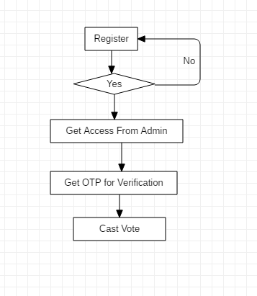
Block Diagram
A block diagram is a diagram of a system in which the principal parts
or functions are represented by blocks connected by lines that show
the relationships of the blocks.

Slide 9
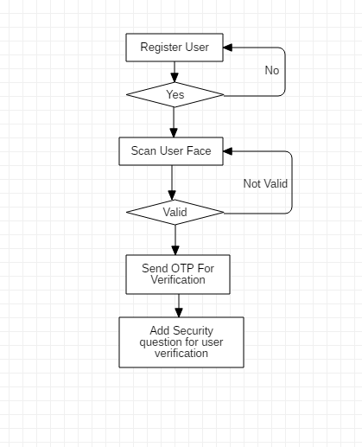
Block Diagram
Admin Block Diagram:-

Slide 10
Methodology
In User side , if the user is first time used this application then they need to register this application and fill the application . When its time to vote , User can get access from admin and receive OTP for verification and cast vote.
In Admin side , Admin accept registration . After admin can scan user face and give access to user .In FDR voters image is captured and passed to algorithm which is used to detect user face from the image and save it as the first matching point.

Slide 11
Methodology
Admin can provide OTP for verification to the user. After that user can cast vote . Admin need to add security question for each user and verify them . An OTP is a password that is only valid for single login session thus improving the security.
Admin can add security question for verify particular user.

Slide 12
Implementation Plan
Activity | Days | Start Date | End date
Guide meeting | 1d | 08/29/19 | 08/29/19
Title Confirmation | 1d | 08/30/19 | 08/30/19
Research on Project | 10d | 09/07/19 | 09/17/19
Resource Gathering | 10d | 09/18/19 | 09/28/19

Slide 13
References
Hari K. Prasad, J. Alex Haldermany , Rop Gonggrijp, Scott Wolchoky, Eric Wustrowy, Arun Kankipati, Sai Krishna Sakhamuri, Vasavya Yagati, “Security Analysis of India’s Electronic Voting Machines”, April 29, 2010.
Sheifali Gupta, O.P. Sahoo, Ajay Goel, Rupesh Gupta, “A New Optimized Approach to Face Recognition Using EigenFaces”, Global Journal of Computer Science and Technology Vol. 10 Issue 1, April 2010.
S. Ravi, S. Wilson, “Face Detection with Facial Features and Gender Classification Based on Support Vector Machine”, 2010 Special Issue - International Journal of Imaging Science and Engineering.

Slide 14
References
Hemlata Sahu , Anupam Choudhray, “Polling System Using GSM Facility”, International Journal of Scientific & Engineering Research. Volume 2, Issue 10, Oct-2011.
Mr. Mayur Patil, Mr. Vijay Pimplodkar, Ms. Anuja R. Zade, Mr. Vinit Vibhute, Mr. Ratnakar Ghadge, “A Survey on Voting System Techniques”, International Journal of Advanced Research in Computer Science and Software Engineering, Volume 3, Issue 1, January 2013 ISSN: 2277 128X.
Feng -Li Lian, Yi-Chun Lin, Chien -Ting Kuo, and Jong-Hann Jean, “Voting-Based Motion Estimation for Real-Time Video Transmission in Networked Mobile Camera Systems”, IEEE TRANSACTIONS ON INDUSTRIAL INFORMATICS, VOL. 9, NO. 1, FEBRUARY 2013

